Slide 1







Speaker Series
FOSTERING HOPE
AVERTING
CRISIS
By Sharri Burggraaf

Slide 2



Definition of a Crisis
According to NAMI National Alliance on Mental Illness
A mental health crisis is any situation in which a person’s behavior puts them at risk of hurting themselves or others and/or prevents them from being able to care for themselves or function effectively in the community.

Slide 3
Alternatives to Calling 911 or Going Inpatient
  Crisis Intervention Teams (CIT) Partnership of law enforcement, mental health professionals, advocates with lived mental illness and addictions.
  Mobile crisis team (MCT) Connected with a crisis line, police, hospitals dispatched to your home.
  Respite and Residential services short stay with counseling, social activities, treatment planning, and daily living skills.
  Walk-in Crisis Services some accept law enforcement drop offs to avoid arrests or hospitilization.

Slide 4
Resources: Crisis Lines
Local Crisis Number: Contact NAMI (Mon - Fri 10 A.M. – 10 P.M. ET.)
Call 1-800-950-NAMI (6264) Text "HelpLine" to 62640
National Suicide Prevention Lifeline 1-800-273-TALK (8255)
Call or text 988
In US Text BEGIN to 741 741 (HOME)
In Canada text CONNECT to 686868
In UK text SHOUT to 852 58
Domestic Violence 800-799-7233 Text START to 88788
Human Trafficking 888-373-7888 Text INFO to 233733

Slide 5

A person experiencing a mental health crisis can’t always clearly communicate their thoughts, feelings, needs or emotions. They may also find it difficult to comprehend what others are saying.

Slide 6
Crisis Prevention Plan
A plan of action for you as an individual
that’s created to avert a crisis
Mental Health Directive
A tool created for others to know your treatment preferences if a crisis should occur.

Slide 7
Establishing Safety (Externally)
Where you live, who you live with and the people
you choose to have in your life
Establishing Safety (Internally)
By accepting parts, working with persecutor and
prosecutor parts and inner conflicts with a
therapist and on your own

Slide 8
Potential Risk Factors
External situations and circumstances that can contribute to a person’s vulnerability to engage in unhealthy coping patterns and behaviors and increase the risk of a crisis.
Coping Patterns/Behaviors
Internal strategies or actions (healthy or unhealthy) that individuals use to manage or alleviate the effects of emotional pain, stress and triggers brought on by our high risk factors. Patterns and behaviors can be changed.

Slide 9


Potential Risk Factors
Substance Abuse
Sleep Patterns
Isolation and Withdrawal
Relationships
Neglecting Physical Care
Inadequate Therapy or Support
Unhealthy Coping Mechanisms
Financial Instability
Financial Dependence
Overuse of Technology
Sudden Life Changes
Grief or Loss
Compromised Safety
Past Trauma Triggers

Slide 10


SUBSTANCE
ABUSE
  INCREASED RISK OF VIOLENCE
  HINDERS EMOTIONAL REGULATION
  IMPULSIVE OR RISKY DECISION-MAKING
  IMPAIRS COGNITIVE FUNCTION TO PLAN OR PROBLEM SOLVE
  COMPROMISES SITUATIONAL AWARENESS
  INCREASES LACK OF JUDGEMENT
  IMPACTS PHYSICAL HEALTH
  INTERFERES WITH POSITIVE COPING STRATEGIES
  Traumatic Memory Escalation
  Increases Isolation, Withdrawal & Loneliness
  Legal Consequences (criminal charges, fines)
  Financial Strain (Maintaining a habit can be expensive causing financial instability)

Slide 11
LACK OF
SLEEP
  EMOTIONAL INSTABILITY
  Psychotic symptoms
  IMPAIRED COGNITIVE FUNCTION TO PROBLEM SOLVE AND MAKE DECISIONS
  INCREASED STRESS
  IMPAIRED JUDGMENT AND RISKY BEHAVIORS
  PHYSICAL HEALTH IMPACT
  INTERFERENCE WITH COPING
SLEEP DEPRIVATION IS A COMMON METHOD OF TORTURE USED IN RA/MC TO BREAK DOWN PSYCHOLOGICAL DEFENSES, INDUCE A STATE OF EXTREME VULNERABILITY TO BE MORE SUSCEPTIBLE TO MANIPULATING THEIR MIND, COERCING THEM TO COMPLY, MAKING SUGGESTIONS THAT HAVE DEVASTATING CONSEQUENCES. THIS CAN LEAD TO CHRONIC SLEEP DISTURBANCE.

Slide 12
ISOLATION
WITHDRAWAL
  LIMITED SUPPORT LEAVES INDIVIDUALS FEELING ALONE AND HELPLESS
  Rumination and overthinking increasing negative thoughts
  LOSS OF PERSPECTIVE AND UNBALANCED VIEW OF THEIR SITUATION
  EMOTIONAL INTENSIFICATION
  LACK OF COPING RESOURCES

Slide 13
RELATIONSHIP
ISSUES
  EMOTIONAL TURMOIL FROM CONFLICTS
  Lack of Support
  Resorting to Negative unhealthy Coping
  SOCIAL WITHDRAWAL, ISOLATION, LONELINESS
  Mental health
De-escalation

Slide 14
NEGLECTED
PHYSICAL
HEALTH
  IMPAIRED OVERALL SELF-CARE (NEGLECTING PHYSICAL CARE LEADS TO NEGLECT OF OVERALL WELL-BEING, INCLUDING MENTAL HEALTH)
  EMOTIONAL DISTRESS FROM CHRONIC PAIN, ILLNESS, FATIGUE ETC.
  Reduced Physical & Mental Resilience

Slide 15
INADEQUATE
THERAPY
& SUPPORT
  UNADDRESSED TRAUMA
  Unresolved Issues
  SOCIAL ISOLATION
  LIMITED RESILIENCE

Slide 16
UNHEALTHY
COPING
  SOCIAL WITHDRAWAL & LONLINESS
  Escalating Traumautic Memory (Our minds try to find a way to heal)
  AMPLIFIES DISTRESS
  Interferes with Positive Solutions
  Compromises Judgment & Decision Making

Slide 17
FINANCIAL
INSTABILITY
  REDUCED COPING
  Worsening Overall Well-being
  Potential for Legal Consequences: (losing a home, car, or a legal battle)
  HEIGHTENING STRESS
  Limits Access to Therapeutic Resources (not being able to afford therapy)

Slide 18
FINANCIALLY
DEPENDENCE
  LIMITED INDEPENDENCE (MAY RESTRICT THE SURVIVOR'S ABILITY TO SEEK HELP OR LEAVE AN ABUSIVE SITUATION)
  Financial Instability (worry if person providing finances dies or withdraws money)
  BARRIER TO RECOVERY (BY BEING TOO DEPENDENT ON THEM)
  Heightened Stress
  Control and Manipulation (if in abusive situation)

Slide 19
OVERUSE OF
TECHNOLOGY
  SOCIAL ISOLATION & LACK OF CONNECTION WITH PEOPLE
  Cyberbullying
  Comparison inadequacy & Anxiety
  ONLINE VULNERABILITY TO HARMFUL SITUATIONS
  Detachment from real-life issues
  Digital Overload

Slide 20
SUDDEN LIFE
CHANGES
  DISRUPTION OF STABILITY AND SECURITY
  Uncertainty of the Unknown
  Loss and Grief
  ADAPTATION CHALLENGES
  Impact on Support Systems

Slide 21
LOSS
GRIEF
  EMOTIONAL OVERWHELM
  Impact on Mental Health (depression, anxiety)
  Isolation and Social Withdrawal
  COPING CHALLENGES
  Triggers of past trauma

Slide 22
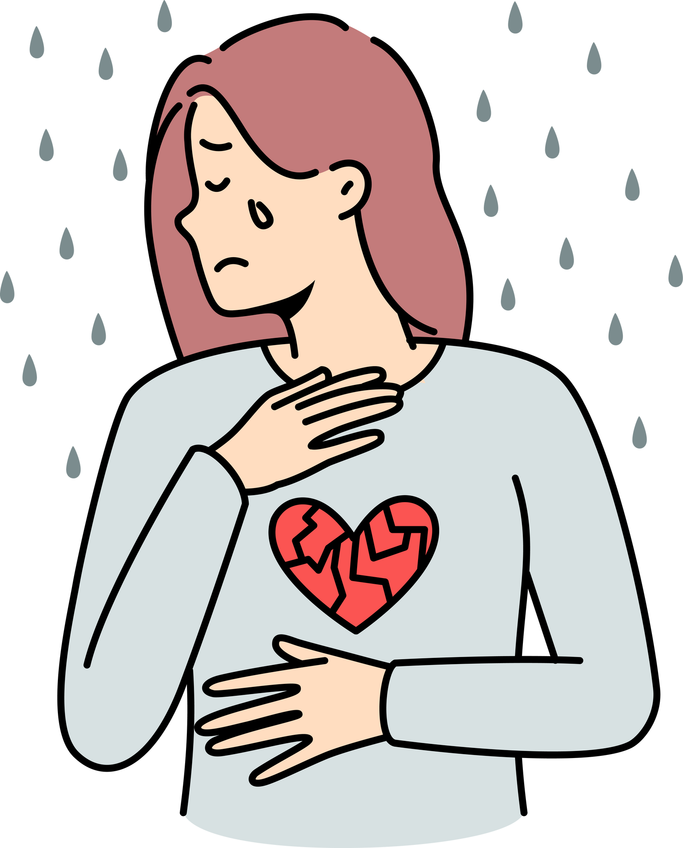
COMPROMISED
SAFETY
  HEIGHTENED HYPERVIGILANCE & FEAR OF DANGER
  Insecurity
  Reduced Coping
  Potential for Present Trauma

Slide 23
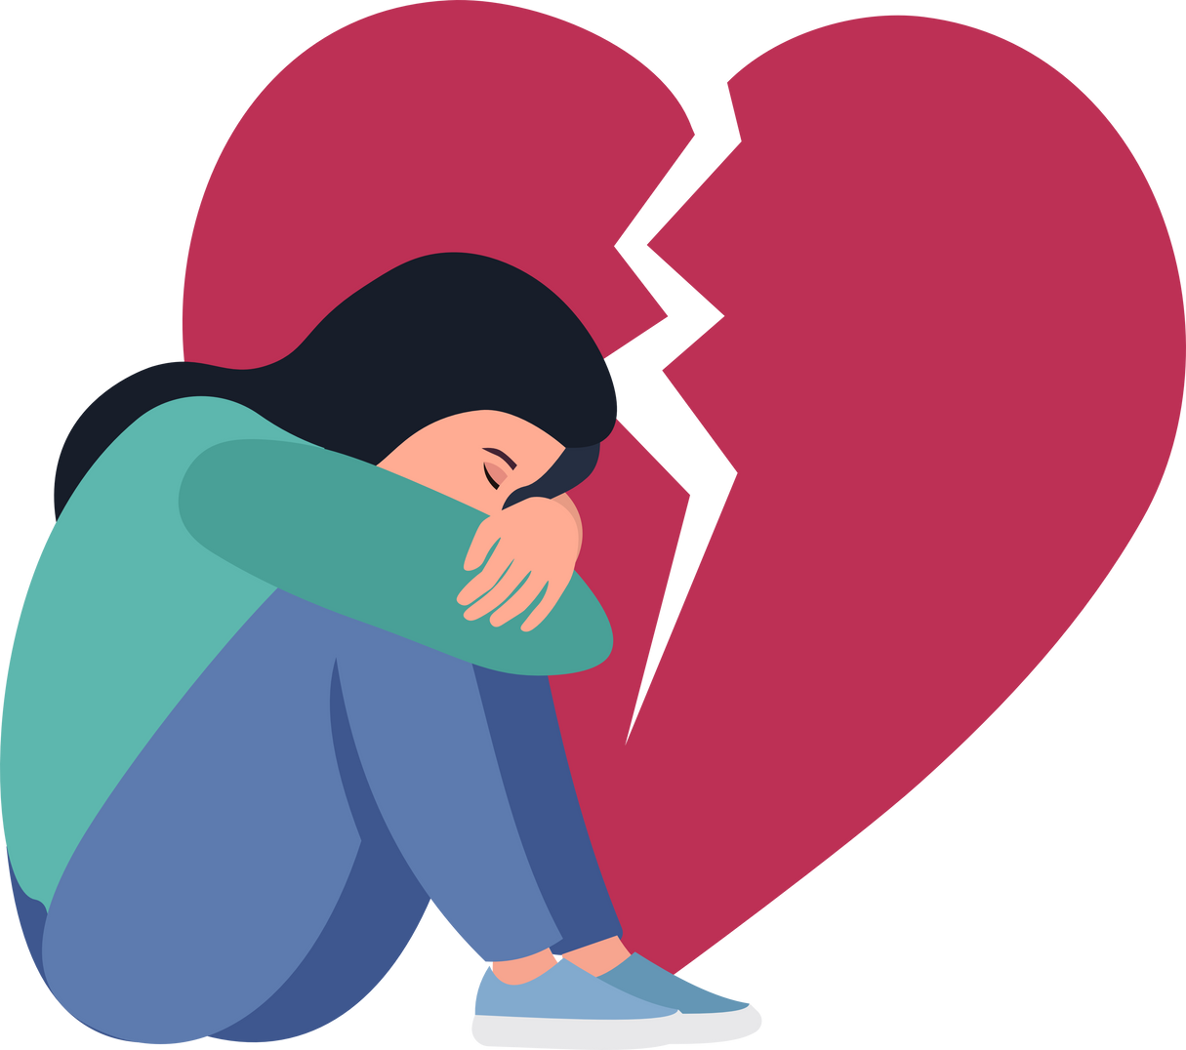
TRAUMA
TRIGGERS
  INTENSE EMOTIONAL RESPONSES
  Flashbacks and Memories
  DISRUPTION OF COPING
  HEIGHTENED VULNERABILITY

Slide 24
P.L.E.A.S.E.
SKILL
  P Physical health
  L LIMIT SCREEN TIME
  E Eat 3 meals a day
  A Avoid mood altering substances
  S Sleep at least 7 or 8 hours
  E Exercise 15 to 30 minutes a day 5 days a week

Slide 25
BREATHING
EXERCISE
Take deep breaths in through the nose and then slowly exhale out your mouth
will lower your heart rate, cause your breathing to be more regular and get the body’s stress responses back to being more calm and then regulate your emotions to a more manageable level.

Slide 26
TIP THE
TEMPERATURE
SPLASH COOL WATER ON YOUR FACE WHICH CAUSES
THE DIVER’S REFLEX THAT REGULATES THE BODY
TEMPERATURE BRINGING AND HAS A CALMING EFFECT
ON EMOTIONS
(Doesn’t work if someone else does it)

Slide 27


COPING
PATTERNS
BEHAVIORS
  Substance Use (alcohol, drugs)
  Misuse of prescription medications
  Self-harm (e.g., cutting, burning)
  High Risk Sexual Behavior
  Isolation and Withdrawal from Others
  Impulsive or Reckless Actions
  Emotional Overeating or Undereating
  Avoidance of Triggers or Stressors
  Overworking or Perfectionism
  Avoidance of Seeking Professional Help
  Suicide Attempts
  Engaging in Self-Blame or Negative Self-Talk
  Dissociation (feeling disconnected from oneself)
  Excessive Use of Technology (e.g., social media)
  Avoidance of Medical or Health Care
  Engaging in Aggressive Behavior
  Excessive use of video games or binge-watching movies or TV

Slide 28
When to Create
A Crisis
Prevention Plan
NOT WHEN FEELING
HOPELESS, HELPLESS
OR WANTING TO HARM
WHEN YOU'RE
FEELING SAFE
SECURE AND STABLE

Slide 29
H.O.P.E.
HEALTHY OUTCOMES FROM PAINFUL EXPERIENCES

Slide 30



SELF-EMPOWERMENT
STRENGTH
STRATEGIES
SELF
We can find a strength that emerges that we didn’t know we had. Adversity can reveal the resilience and fortitude we possess.
Challenges often compel us to explore healthier ways to navigate and manage adversity and learn new coping strategies.
Our self-exploration and self-awareness can help us discover our identity, values true passions, purpose and life goals.

Slide 31
THANK
YOU!

